Slide 1

Community-Based Care
Stakeholder Webinar
September 20, 2018

Slide 2
AGENDA
What is Community-Based Care?
Background
Implementation
Advantages & Outcomes
Questions

Slide 3
What is Community-Based Care (CBC)?
A new way of providing foster care and case management services
It's a community-based approach to meeting the individual and unique needs of children, youth, and families
Within a geographic service area, a single contractor (officially a Single Source Continuum Contractor or SSCC) is responsible for finding foster homes or other living arrangements for children in state care and providing them a full continuum of services
Changes the way the agency procures, contracts, pays

Slide 4


Slide 5
Background
Current child welfare system structure does not encourage establishment of services, including residential placements, where they are needed.
Very few providers offer the full continuum of services to support children and families.
As a result, some children must move to locations (outside of their home communities) and too often must change placements as a result of a change in service needs.

Slide 6
Senate Bill 11
Expands Foster Care Redesign to Community-Based Care (CBC)
Adds kinship care, case management and reunification services
Shifts DFPS’ role to quality oversight of conservatorship services
Allows DFPS to begin identifying 8 new catchment areas, with implementation subject to appropriation

Slide 7
Case Management
The provision of case management services to a child for whom the department has been appointed TMC or PMC or to the child's family, a young adult in extended foster care, a relative or kinship caregiver, or a child who has been placed in the catchment area through ICPC, and includes, but is not limited to:
Caseworker visits with the child, family and caregivers;
Convening and conducting permanency planning meetings;
Development & revision of child and family plans of service, including a permanency plan & goals for a child or young adult in care;
Coordination & monitoring of services required by the child & the child's family;
Assumption of court-related duties regarding the child; and
Any other function or service that the department determines necessary to allow a SSCC to assume responsibility for case management.

Slide 8
Court-Related Duties
Providing any required notifications or consultations;
Preparing court reports;
Attending hearings, trials, and mediations;
Complying with applicable court orders;
Working with attorneys to prepare for trials and staff cases as needed;
Working with all legal parties on the case;
Ensuring the child is progressing toward the goal of permanency within state and federally mandated guidelines.

Slide 9
Implementation
Plan required by Texas Family Code §264.153
Rolling out catchment area by catchment area
Sets forth quality indicators
Staged rollout in each catchment area

Slide 10
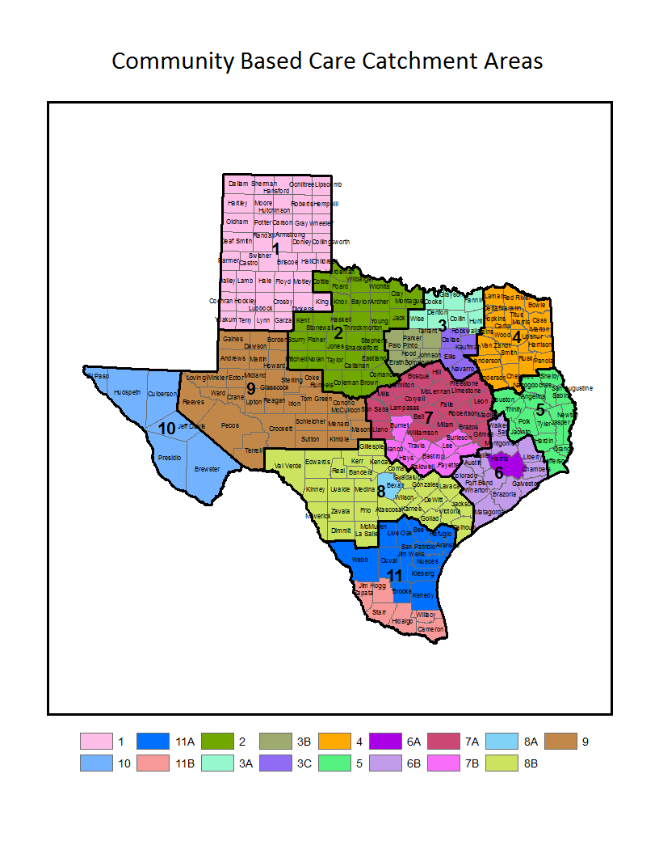
Community-Based Care Catchment Areas

Slide 11
Foundation
Quality Indicators:
Above all, children and youth are safe from abuse and neglect.
Children and youth are placed in their home communities.
Children and youth are appropriately served in the least restrictive environment.
Children and youth have stability in their placements.
Connections to family and others important to the child are maintained.
Children and youth are placed with their siblings.
Services respect the child's culture.
Children and youth are provided opportunities, experiences, and activities similar to those enjoyed by their peers who are not in foster care.
Youth are fully prepared for successful adulthood.
Youth have opportunities to participate in decisions that affect their lives.
Children and youth are reunified with their biological parents when possible.
Children and youth are placed with relative or kinship caregivers if reunification is not possible.

Slide 12
Staged Implementation
Stage I will include the provision of paid foster care placement services
Stage II will include the provision of substitute care placement & case management services
Stage III will include:
The provision of services outlined in Stage I and II; and
Holding the SSCC financially accountable through the use of incentives and remedies for the timely achievement of permanency for served children beginning 18 months after case management services have transferred.

Slide 13
Foster Care Redesign Catchment Areas (Initial)
Regions 2 and 9
Providence Service Corporation
February 2013-August 2014
Served approx. 1100 children/youth
Region 3b
December 2013 – present
Serve approx. 1350 children/youth

Slide 14
Implementation Updates
Region 3B:
September 1, 2018, SSCC contract renewed with Our Community Our Kids through end of FY 2020
Contract includes:
Continuation of services provided under Stage I
Requirements of Stage II and III
DFPS and ACH are currently working on plans for transition that is seamless to children, youth and families in 3b
Once all plans are finalized and approved, DFPS and ACH will share plans with children, families, staff, members of the judiciary, and other stakeholders.

Slide 15
Implementation Updates
Region 2:
RFA released on October 18, 2017
Contract awarded to 2INgage in June 2018
Stage I roll-out in December 2018 (after 6-month start-up period)
Stage II roll-out is based on SSCC and DFPS readiness

Slide 16
Implementation Updates
Region 8a (Bexar County):
RFA released on December 5, 2017
Contract awarded to Family Tapestry in August 2018
Stage I roll-out in February 2019 (after 6-month start-up period)
Stage II roll-out is based on SSCC and DFPS readiness

Slide 17
Implementation Updates
New Catchment Areas:
Announced 2 new catchment areas in August 2018
Region 1
Region 8b (all counties excluding Bexar)
Anticipate releasing a RFA for Region 1 in October 2018 and for 8b in March 2019

Slide 18
Advantages to Children, Youth and Families
Additional resources for children, youth and families due to the flexibility of the model
Community engagement resulting in increased support and better outcomes for children and youth
More efficient communication and better coordination among providers serving families and children
More substantive communication between DFPS and providers
Services brought to the child and family

Slide 19
Region 3b SSCC - Outcomes
Children/Youth Placed in Paid Foster Care:
Children and youth are safe in foster care
Children and youth are spending less time in congregate care and more time in foster homes
Children and youth in foster homes are being placed closer to home
Foster home placements are more stable
Increased foster care capacity, including therapeutic care
Increased community engagement and partnerships

Slide 20

QUESTIONS

Slide 21
Information on Community-Based Care can be found on the DFPS website: https://www.dfps.state.tx.us/Child_Protection/Foster_Care/Community-Based_Care
Additional questions may be submitted to the mailbox at:
CBCare@dfps.state.tx.us

