Slide 1
CPS Kinship Program Updates CPS Stakeholder Webinar April 4, 2019
Kristene Blackstone
Associate Commissioner for CPS

Slide 2

Kinship Care
Kinship Care is provided by a person who:
Has not been verified as a foster parent or otherwise licensed to provide 24-hour residential child care but has been formally approved by DFPS.
Home Assessment completed
Review and approval by DFPS
Formal approval makes the unverified kinship caregiver potentially eligible for financial help under the DFPS Relative and Other Designated Caregiver Program

Slide 3
Benefits of Kinship Care
Provides love and care in a familiar setting;
Provides parents with a sense of hope that children will remain connected to their birth families;
Enables children to live with people they know and trust;
Reinforces a child's sense of cultural identity and positive self-esteem;
Helps a child make and sustain extended family connections;
Continues lifelong family traditions and memories;
Supports the child in building healthy relationships within the family;
Supports the child's need for safety and well-being; and
Creates a sense of stability in the life of a child.

Slide 4
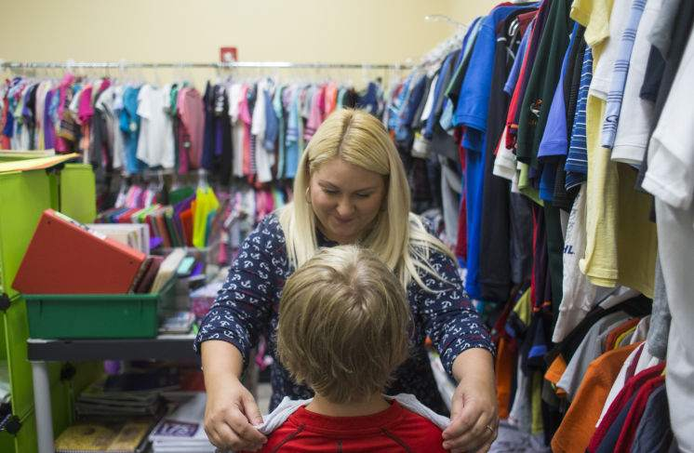
Kinship Program
Kinship development caseworkers (KDW) provide support and resources for unverified kinship caregivers.
The KDW serves as the primary caseworker responsible for finding local resources to meet the child’s and caregiver’s needs.

Slide 5

Relative and Other Designated Caregiver Program (RODC)
To help unverified kinship caregivers care for children, limited financial assistance is available through the DFPS Relative and Other Designated Caregiver Program (RODC).

Slide 6

Relative and Other Designated Caregiver Program (RODC)
Effective September 1, 2017, HB4 replaced the Integration Payment and the Annual Reimbursement with the Kinship Monthly Reimbursement
$11.55 per day per child
Once per month
Time-limited for the child and paid for up to 12 months

Slide 7
Kinship Monthly Reimbursement Eligibility
Child being placed must be in DFPS conservatorship
Child is being placed with a kinship caregiver formally approved by DFPS through the home assessment process
The home in which the child is being placed is not a verified foster or group home receiving foster care maintenance payments
Caregiver must sign and abide by the Kinship Caregiver Agreement
Caregiver’s family income does not exceed 300 percent of the current federal poverty limit. Total family income must include all household members.

Slide 8





Kinship Monthly Reimbursement
In FY 2018, DFPS reimbursed approximately 9,822 caregivers for the cost of caring for 16,872 children in conservatorship

Slide 9

Post-Permanent Managing Conservatorship Reimbursement Payment
Kinship caregivers can request an annual reimbursement of up to $500 per child for child-related costs if the kinship caregiver obtains permanent managing conservatorship (PMC) of the child
An eligible kinship caregiver may request the reimbursement for the three years following the award of PMC of the child, or until the child reaches age 18, whichever comes first.

Slide 10
Kinship Growth
*Data Book

Slide 11
Kinship Foster Parents
DRIT D90115 Relative Verified Foster Homes

Slide 12
Kinship Adoptions

Slide 13

Kinship Collaboration Group (KCG)
Kinship Caregiver Collaboration Group
Partnering with kinship caregivers who give CPS a unique and valuable perspective on how to improve services to families and children.

Slide 14

Regional Kinship Caregiver Support Groups
A subset of the Kinship Caregiver Collaboration Group is Regional Kinship Caregiver Support Groups (KSG).
Provide regional/local opportunities for Kinship caregivers with open CPS cases to get greater insight of the CPS system
Get input from kinship caregivers on methods to improve safety, permanency and well-being for children receiving CPS services and meaningful engagement of kinship caregivers and families

Slide 15
Collaborative Family Engagement
Texas CASA and DFPS created in 2015
Based on Family Finding Model
Primary Goals are
Strengthen collaboration to identify family members and fictive kin
Establish a lifetime network of adults to provide support to children and parents
31 counties and counting

Slide 16

Kinship Navigator
Family First Prevention Services Act (FFPSA) provides potential federal funding to states with Kinship Navigator Programs
DFPS is working with the University of Houston to research Kinship Navigator Programs
Provide Options
Determine Costs

Slide 17

Kinship Navigator (continued)
Kinship Navigator Program goals could include:
Strengthen, streamline, and expand the network of services and supports available to kinship caregivers and their families
Aid in preventing informal kinship families from unnecessary hardships
Empower families to overcome challenges outside of child welfare system

Slide 18

Questions about Kinship
Debbie.Bouldin@dfps.state.tx.us
Kinship and PCA Program Specialist Anna.McArtor@dfps.state.tx.us
Kinship Program Specialist DFPS website
dfps.state.tx.us

